Slide 1
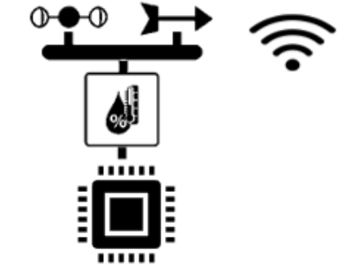


Design of Real Time weather monitoring instrument using Internet of thing Module
Sougat kr. Sarangi (CE21D300)
Abhishek kishor (CE23E009)
Shakeel Ah. lone (CE23E012)
Prof. Dr. Chandan Sarangi
Dept. of Civil Engineering
IIT Madras

Slide 2
Objective
Objective Design & Development of Wind anemometer, Rain gauge and vane Integration of sensor with IOT Board Internet of thing Real time Weather monitoring | Workflow
Learning How meteorological instruments work Analysis and Design Internet of things Computer aided design
Start
Literature survey & Market study
Level 1
Design Constraint
Level 2
Computer Aided Design & Simulation
Level 3
Individual Hardware interfacing & Testing
Level 4
Sensor integration & Testing
Level 5
Embedding IoT into sensor network
Level 6
Sensor Calibration & Data validation
Stop
Finished Product

Slide 3
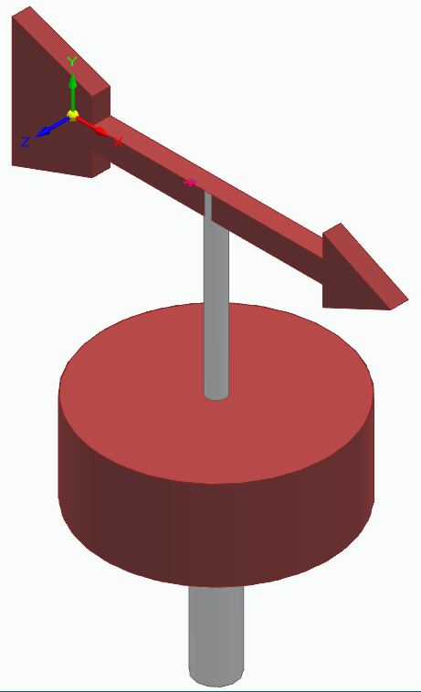

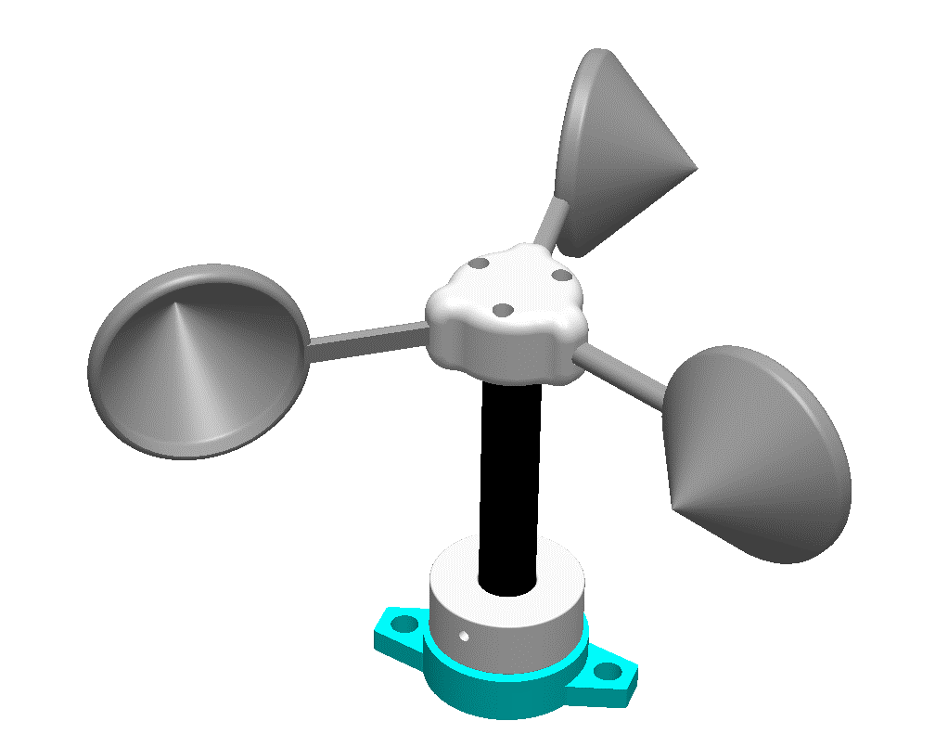
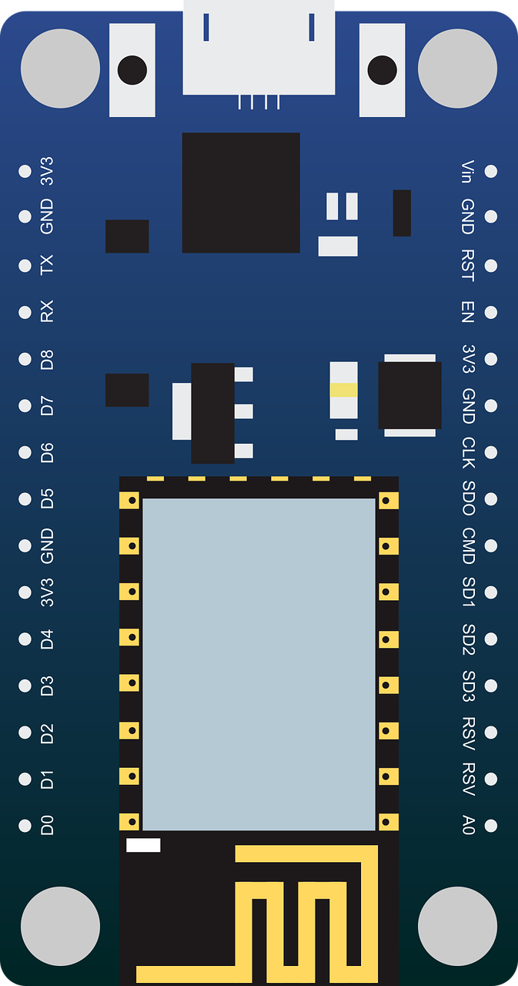


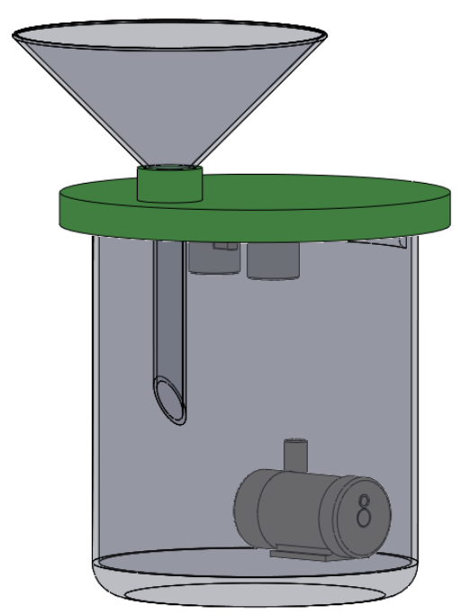







Block Diagram
POWER SOURCE (DC SOURCE)
WEB / MOBILE APP
Wind Direction
North East / 45°
Arduino Board
NETWORK
ES8266
PROCESSING
Wind speed
2.4 m/s
Rainfall
15 mm
END USER
Design of Real Time weather monitoring instrument using IOT module

Slide 4
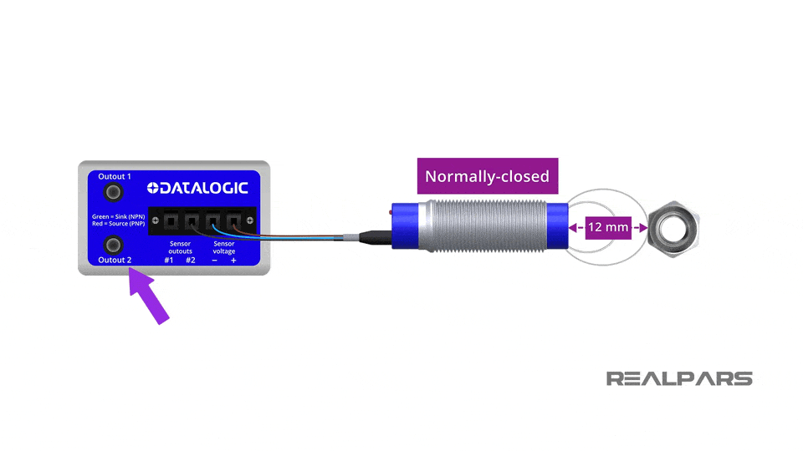
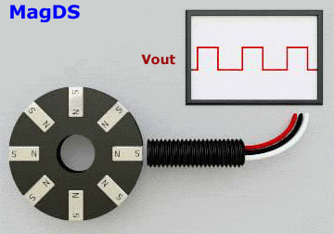
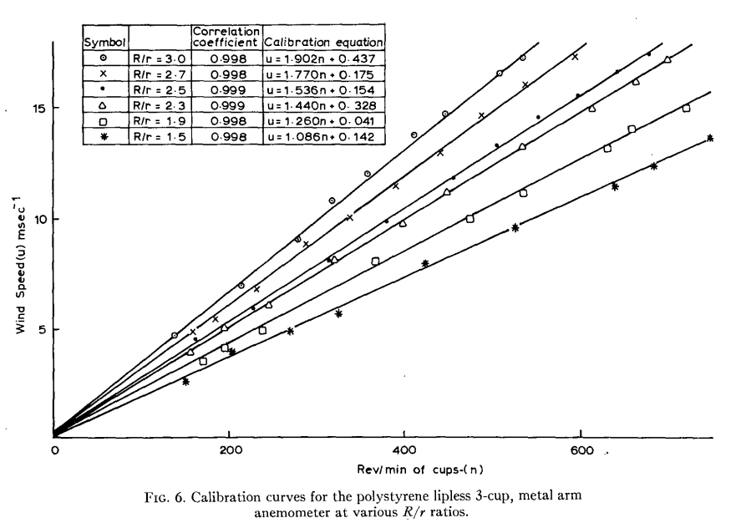
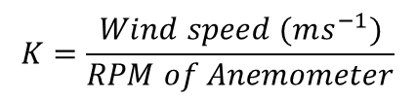
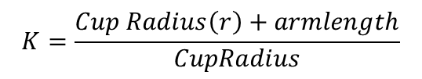
Cup Anemometer
cup Anenometer
3 - cup anemometer
Proximity Sensor
 | Design constraint Cup Anemometer factor (K)
four-cup anemometer developed by Robinson of Ireland in 1846. Pindado (2012) Test 21 different cup & arm model and find analytical model of Kondo et al.(1972) was proved to be accurate So, Observations from Lindley(1975) and pindaDo (2012)suggest that K factor to be 0.4.
Cup arm
$$K=\frac{Wind speed (ms^{−1})}{RPM of Anemometer}$$
$$K=\frac{Cup Radius\left(r\right)+armlength}{CupRadius}$$
Source : D. Lindley(1975)

Slide 5
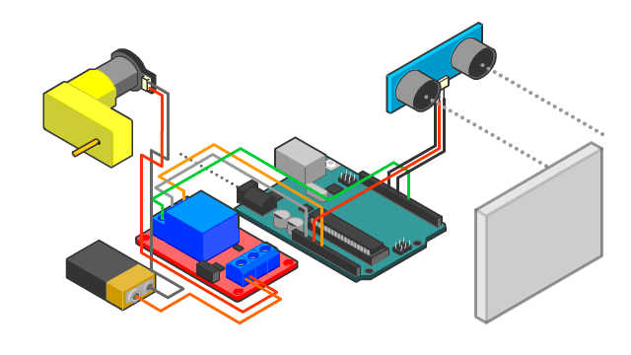
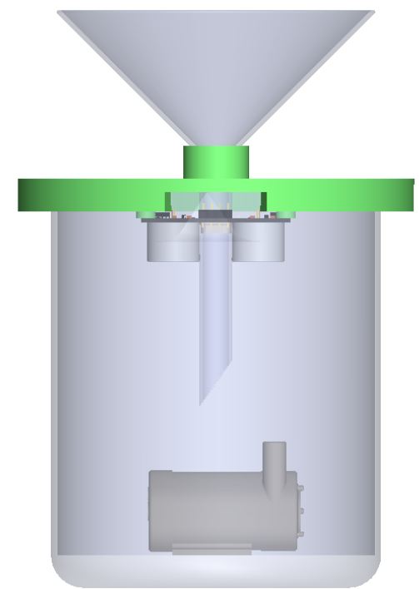
Rain Guage
cup Anenometer
3D CAD Design | Working Principle
Ultrasonic Sensor
Pump
Catchment Funnel
Arduino
Waterproof Cover
Ultrasonic Sensor
Sender
Receiver
Relay Switch
Motor
Motor Switches ON when it reaches threshold

Slide 6
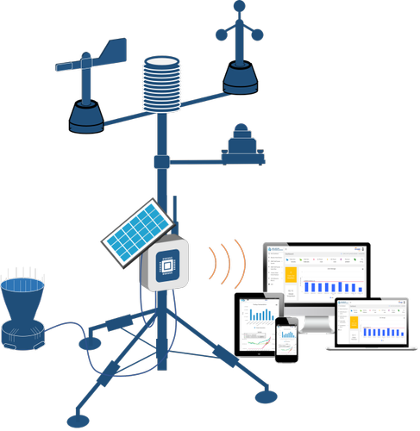
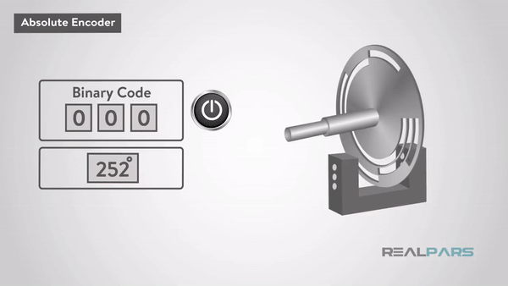
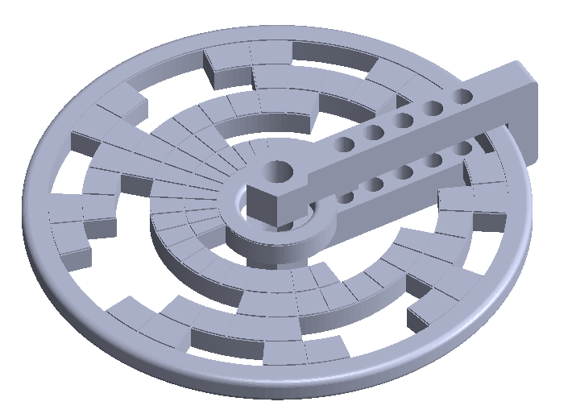
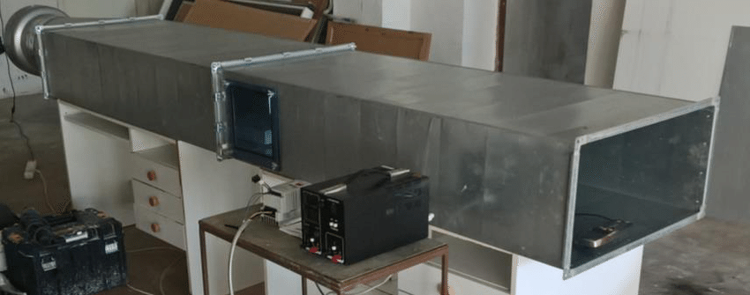
Future work
Gray Coded Optical Encoder
Wind Vane Development | Final Integrated Real Time Weather Monitoring System
Calibration and Data Validation
Vane
Shaft
Code Disc
Shaft
LDR
LED

Slide 7
References
Anemometer
Avallone, E. et al. (2019) ‘An inexpensive anemometer using Arduino board’, Facta universitatis - series: Electronics and Energetics, 32(3), pp. 359–368. doi:10.2298/fuee1903359a.
Carlos-Mancilla, M.A. et al. (2020) ‘Educational mechatronics and internet of things: A case study on dynamic systems using meiot weather station’, Sensors, 21(1), p. 181. doi:10.3390/s21010181.
Coquilla, R.V., Obermeier, J. and White, B.R. (2007) ‘Calibration procedures and uncertainty in wind power anemometers’, Wind Engineering, 31(5), pp. 303–316. doi:10.1260/030952407783418720.
Lindley, D. (1975) ‘The design and performance of a 6-Cup anemometer’, Journal of Applied Meteorology, 14(6), pp. 1135–1145. doi:10.1175/1520-0450(1975)014&lt;1135:tdapoa&gt;2.0.co;2.
Pindado, S., Cubas, J. and Sorribes-Palmer, F. (2014) ‘The cup anemometer, a fundamental meteorological instrument for the wind energy industry. research at the IDR/UPM Institute’, Sensors, 14(11), pp. 21418–21452. doi:10.3390/s141121418.
Sharifabad, H.K., Mirzaei, O. and Talebi, M.H. (2011) ‘Design anemometer with transistor’, Applied Mechanics and Materials, 110–116, pp. 2628–2630. doi:10.4028/www.scientific.net/amm.110-116.2628.
Sheppard, P.A. (1940) ‘An improved design of cup anemometer’, Journal of Scientific Instruments, 17(9), pp. 218–221. doi:10.1088/0950-7671/17/9/301.

Slide 8

RESULTS DEMONSTRATION

Slide 9
Thank You

Slide 10
Questions?

Slide 11
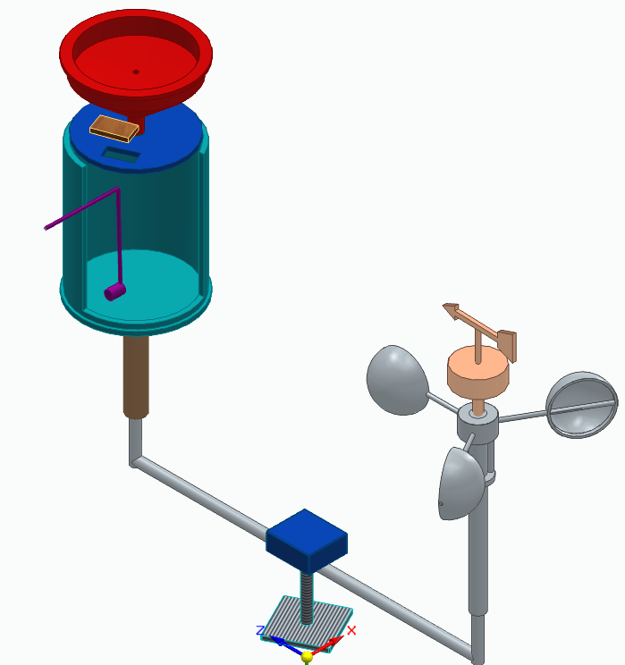
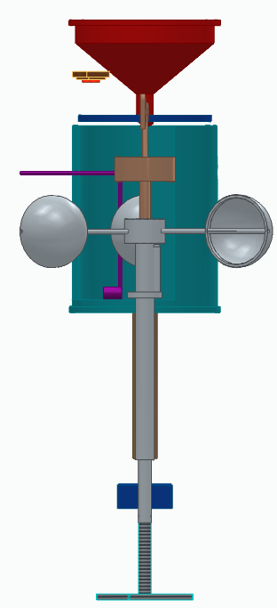
Proposed CAD Model
Final model
Rain gauge
Vane
Anemometer

